Slide 1
CORDS and BIOSECURITY
Professor Nigel Lightfoot CBE Executive Director

Slide 2
The CORDS Network
Six Major Regional Networks

Slide 3
CORDS Strategic Orientation
Strategic Priorities
Key Strategies
Performance
Improving
Capacity
Knowledge Generation, Mgmt and Sharing
Joint Research
Resource Sharing
CORDS
2015
World class coordination and support network linking regional disease surveillance networks to improve global capacity to respond to infectious diseases.
Advancing
One Health
Engagement of Human, Animal and Environmental Health Organizations
Endorsement of Multi-Sectoral Initiatives
CORDS
2012
Promoting
Innovation
Publishing and Sharing of Innovative Results
Encouragement of Co-Development Projects
Piloting of Advances in Surveillance
Building Sustainable Networks
Strengthening of Existing Networks
Promotion of the Development of New Networks
Feedback
2012 to 2015: Priorities, Strategies, Performance and Feedback

Slide 4
CORDS Funding
Objective 1 – Rockefeller $1.0M 2 years
Objective 3 – Gates $1.5M 2 years
Objective 4 – Skoll $1.0M 2 years
Objective 2 – not funded yet

Slide 5
The World is Changing
The internet
Mobile phone technology
Emerging diseases
New diseases
Changes in endemic diseases
Climate change
Vector changes

Slide 6
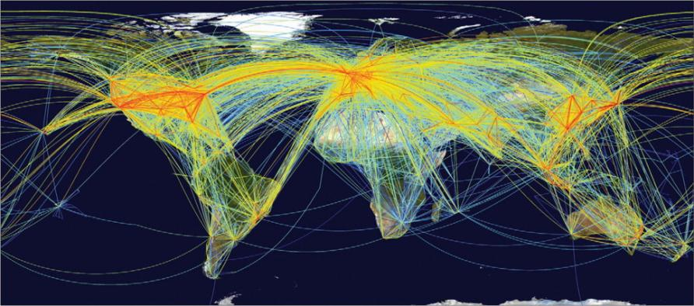
Global aviation network Disease can spread anywhere in 24 hrs
Source: Kilpatrick AM, et al. Drivers, dynamics, and control of emerging vector-borne zoonotic diseases. The Lancet 380:9857, 1-7 Dec 2012, pp. 1946-55. www.sciencedirect.com/science/article/pii/S0140673612611519
Note: Air traffic to most places in Africa, regions of South America, and parts of central Asia is low. If travel increases in these regions, additional introductions of vector-borne pathogens are probable.

Slide 7
Why we need to do better
SARS
Pandemic influenza H1N1 2009
Hand foot and mouth disease
Nodding disease
Skin disease in Vietnam
New coronavirus
The next pandemic

Slide 8
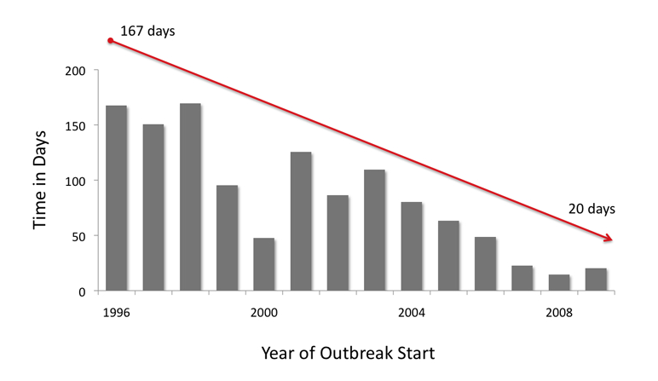
Time from outbreak start to outbreak discovery is shrinking
Source: Chan EH, et al. Global capacity for emerging infectious disease detection, December 14, 2010, 107:50, pp. 21701-21706; www.pnas.org/cgi/doi/10.1073/pnas.1006219107
Notes:
From this article: http://www.pnas.org/content/early/2010/11/18/1006219107.abstract

Slide 9
Progress in Ebola outbreak detection and response, Uganda
Improved testing/monitoring for Ebola outbreaks
Year | Response timeline | No. of cases
2000 | 38 days from 1st known case to preliminary investigation | 425
2007 | 2.5 months from 1st known case to preliminary investigation | 131
2011 | 1 day between case confirmation and response | 1 confirmed case
2012 | 2 days between lab confirmation & response (but 38 days between index death & response – need for quicker response even in absence of lab confirmation) | 24 cases, 16 deaths

Slide 10
The CORDS Concept
From Surveillance to Intelligence
Recognition
Early
Communications
Field
Diagnostics
Communication
Action
Action
Local
Laboratory
Communication
National
Laboratory
Action
Early Communication is the Key!!!

Slide 11
Innovative Operational Research
Speeding up accurate surveillance
Accelerating responses
Reducing time to action
Joining up actions
Joining up data streams

Slide 12
Mobile Technologies - SACIDS
BURUNDI, TANZANIA, ZAMBIA
Cross-sectorial approach
SMS and GeoChat (INsTEDD)
Voice recognition (P4H)
Digital Pen Technology
(handwriting recognition)
Android smartphone, spatial epidemiology EpiCollect programmed system

Slide 13
Next Steps
CORDS has a surveillance platform
One health and cross-sectoral
There are several unconnected initiatives
Skoll Global Threats Fund Initiatives
Flu near you
Expert epidemiologist verification
CORDS needs the right technology
Workshop for all players 2013

