Slide 1
Developing Networks
Professor Nigel Lightfoot CBE, Executive Director

Slide 2
Why CORDS?
Born out of visionary thinkers
  Sam Nunn
  Deborah Rosenblum - NTI
  Laura Holgate - NSS
  Mark Smolinski - SGTF
  Peggy Hamburger – FDA
  “It’s a no-brainer”

Slide 3

Evolution of Disease Surveillance
Middle East Consortium on Infectious Disease Surveillance
Asia Partnership on Emerging Infectious Diseases Research
Southern African Centre for Infectious Disease Surveillance
Electronic Integrated Disease Surveillance System
East African Integrated Disease Surveillance Network
Global Public Health Intelligence Network
Mekong Basin Disease Surveillance Network
Connecting Organizations for Regional Disease Surveillance
South-Eastern Europe Health Network
ProMED Mail
Health Map
1994
1998
1999
2000
2001
2003
2005
2006
2009
2012
Toward Global Real-Time
Bio-surveillance

Slide 4
The CORDS Network
Six Major Regional Networks

Slide 5
Connecting Organizations for Regional Disease Surveillance
The Networks are CORDS
Each Network is partly based in Ministries
Each Network has a coordination unit
The CORDS Board is the Network Chairs
  WHO, OIE, FAO, NTI
  Skoll, Rockefeller, Gates, Fondation Merieux
The CORDS secretariat is established in Lyon
  ED + Assistant + Programme Manager

Slide 6

CORDS Strategic Orientation
Strategic Priorities
Key Strategies
Performance
!. Improving
Capacity
Knowledge Generation, Mgmt and Sharing
Joint Research
Resource Sharing
CORDS
2015
World class coordination and support network linking regional disease surveillance networks to improve global capacity to respond to infectious diseases.
2. Advancing
One Health
Engagement of Human, Animal and Environmental Health Organizations
Endorsement of Multi-Sectoral Initiatives
CORDS
2012
3. Innovative
Research
Innovating Operational Research Projects
Encouragement of Co-Development Projects
Piloting of Advances in Surveillance
4. Building
Sustained
Networks
Strengthening of Existing Networks
Identifying and Comitting New Funders
Promotion of the Development of New Networks
Feedback
2012 to 2015: Priorities, Strategies, Performance and Feedback

Slide 8
CORDS Funding
Capacity Building – Rockefeller $1.0M 2 years
Innovative Operational Research – Gates $1.5M 3 years
Secretariat, Advocacy – Skoll $1.0M 2 years
One Health Workshops – not funded yet
Sustainability – not funded yet
New networks – not funded yet

Slide 9
The Cords Program
Mapping the Networks
Stakeholder Mapping and Engagement
Web portal for virtual library and trusted communications
Communications strategy
Annual Networks Conference
Innovative Operational Research Projects
One health workshops
Advocacy on behalf of the Networks

Slide 10
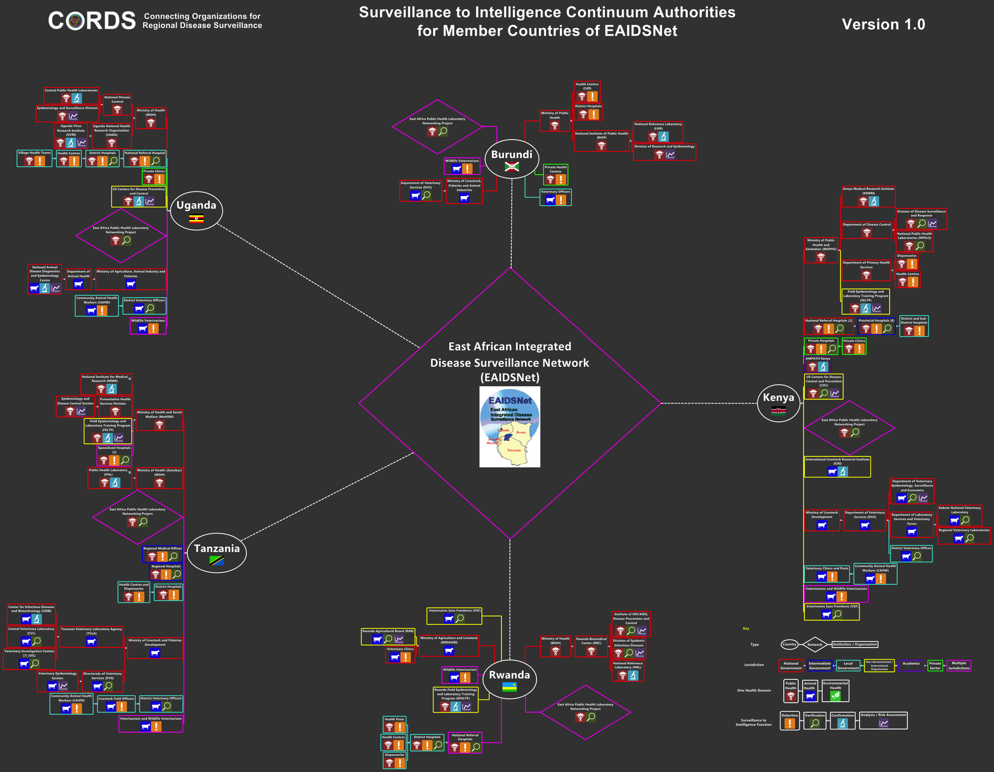

Slide 11
Communications Strategy
Risk communication training
Building trust
Communication is earlier, closer to the event and better
Network communications policy and strategy
Building cross border communication teams
Utilizing the portal

Slide 12
The CORDS Web Portal
Four areas
Corporate public facing
Virtual library of documents and protocols
Password protected
  Discussion forum
  Document development
Daily news alert

Slide 13
Why an Alerting Service?
Encourages interaction of regional network members in a global exchange of information
Encourages regional network members to participate in CORDS information sharing initiatives
Promotes development of CORDS culture of one integrated global network of networks

Slide 14
Proposed Service
Global emerging threat surveillance, news and analysis
Delivered daily with a weekly digest
Ad hoc alerts for serious threats
Risk Assessments and Situation Reports for ongoing serious threats as they develop

Slide 15
Innovative Operational Research
Mobile phone technology and surveillance
Speeding up accurate surveillance
Cross border
Accelerating responses
Reducing time to action
Joining up actions
Joining up data streams

Slide 16
The CORDS Concept
From Surveillance to Intelligence
Recognition
Early
Communications
Field
Diagnostics
Communication
Action
Action
Local
Laboratory
Communication
National
Laboratory
Action
Early Communication is the Key!!!

Slide 17
Developing New Networks
African Union Framework
North Africa?
West Africa?
Pakistan/India/Bangladesh?
Where would you find most value?

Slide 18
CORDS and security objectives?
Threat Agents are endemic
Emerging threats
Surveillance
    Earlier detection
    Earlier communication
    Earlier reporting
Cross border and multilateral
Attention to communication and building trust
Capacity building
Working with Chatham House and IFBA

Slide 19
USG support to CORDS?
A model worth sustaining – well established, tax free, has a governance system.
A platform for implementation
    Operations
    capacity building
    innovative operational research
    one health workshops
    communication – web portal
    news alerting service
    development of new networks
Sustaining CORDS
$10.3M - $12M over five years
Feedback and ? Seat on the board!

