Slide 1
Global Health Security
Professor Nigel Lightfoot CBE Executive Director

Slide 2
Global Health Security
World Health Assembly Definition:
“The need to reduce the vulnerability of people around the world to new, acute, or rapidly spreading risks to health, particularly those that cross international borders”.

Slide 3
The Challenges Today
H7N9 Avian Influenza in China
Novel coronavirus
Emerging threats
Lassa, Ebola, Marburg, Nippah, Hendra, etc.
Zoonoses zoonoses zoonoses

Slide 4
H7N9 SITREP Today
64 cases, 14 deaths
Contact with live poultry, wet markets
Two novel reassortants identified
No human to human transmission – yet
Requires two more gene mutations
Asymptomatic in poultry and wild birds
Spreading in China
Bird migrations

Slide 5
The Challenges Today
Antimicrobial resistance
Tuberculosis
Counterfeit medicines
Access to vaccines
Eradication of malaria
Artemesin resistance
Biosecurity and biosafety

Slide 6
Why H7N9 is different to SARS
SARS was not reported by China for 3 months
Spread to Hong Kong
Spread globally
Toronto
H7N9 reported immediately
Cooperation with WHO
China has shared the virus for scientific studies
Test kits now available all over China

Slide 7
What has been done
Global Health Security Initiative of G7
USAID
The World Bank
Rockefeller Foundation
Gates Foundation
Global Partnership of G8
CORDS – Network of Networks

Slide 8
The CORDS Network
Six Major Regional Networks

Slide 9
CORDS Strategic Orientation
Strategic Priorities
Key Strategies
Performance
Improving
Capacity
Knowledge Generation, Mgmt and Sharing
Joint Research
Resource Sharing
CORDS
2015
World class coordination and support network linking regional disease surveillance networks to improve global capacity to respond to infectious diseases.
Advancing
One Health
Engagement of Human, Animal and Environmental Health Organizations
Endorsement of Multi-Sectoral Initiatives
CORDS
2012
Promoting
Innovation
Publishing and Sharing of Innovative Results
Encouragement of Co-Development Projects
Piloting of Advances in Surveillance
Building Sustainable Networks
Strengthening of Existing Networks
Promotion of the Development of New Networks
Feedback
2012 to 2015: Priorities, Strategies, Performance and Feedback

Slide 10
CORDS Funding
Capacity – Rockefeller $1.0M 2 years
Innovation – Gates $1.5M 2 years
Sustaining – Skoll $1.0M 2 years
One Health – Skoll

Slide 11
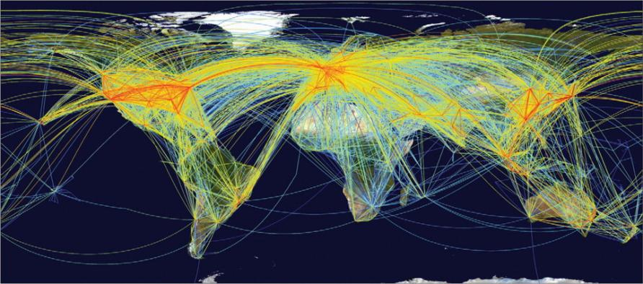
Global aviation network Disease can spread anywhere in 24 hrs
Source: Kilpatrick AM, et al. Drivers, dynamics, and control of emerging vector-borne zoonotic diseases. The Lancet 380:9857, 1-7 Dec 2012, pp. 1946-55. www.sciencedirect.com/science/article/pii/S0140673612611519
Note: Air traffic to most places in Africa, regions of South America, and parts of central Asia is low. If travel increases in these regions, additional introductions of vector-borne pathogens are probable.

Slide 12
Progress in Ebola outbreak detection and response, Uganda
Improved testing/monitoring for Ebola outbreaks
Year | Response timeline | No. of cases
2000 | 38 days from 1st known case to preliminary investigation | 425
2007 | 2.5 months from 1st known case to preliminary investigation | 131
2011 | 1 day between case confirmation and response | 1 confirmed case
2012 | 2 days between lab confirmation & response (but 38 days between index death & response – need for quicker response even in absence of lab confirmation) | 24 cases, 16 deaths

Slide 13
The CORDS Concept
From Surveillance to Intelligence
Recognition
Early
Communications
Field
Diagnostics
Communication
Action
Action
Local
Laboratory
Communication
National
Laboratory
Action
Early Communication is the Key!!!

Slide 14
Innovative Operational Research
Speeding up accurate surveillance
Accelerating responses
Reducing time to action
Joining up actions
Joining up data streams
Joining up networks

Slide 15
Mobile Technologies - SACIDS
BURUNDI, TANZANIA, ZAMBIA
Cross-sectorial approach
SMS and GeoChat (INsTEDD)
Voice recognition (P4H)
Digital Pen Technology
(handwriting recognition)
Android smartphone, spatial epidemiology EpiCollect programmed system

Slide 16
Mobile Technologies Next Steps
CORDS has a wide surveillance platform
One health and cross-sectoral
We are aware of several unconnected initiatives
Skoll Global Threats Fund Initiatives
Flu near you
Expert epidemiologist verification
CORDS needs the right technology
Workshop for all players 2013

Slide 17
Conclusions
One Health is key – on the ground
Joining up of existing systems is necessary
Sharing across borders has to be achieved
Field diagnostics will be helpful
Your research must influence policy
Communication communication communication!

