Slide 1
The assessment and mitigation of zoonoses in Republic of Macedonia
Teamwork
Animal Health Departament
Food and Veterinary Agency
Republic of Macedonia
24-25 April 2015, Bansko, Republic of Bulgaria

Slide 2
Organization and responsibilities of the Food and Veterinary Agency
FVA establishment
–Food Safety Law-2010
- operational-2011

Slide 3
FVA is a Competent authority for:
activities related to food and feed safety and control of the quality of food with exception to primary production of plant origin;
veterinary activities related to animal health and principles and procedures for implementation of activities related to the protection of people and animals against diseases which are transmitted by animals.
identification and registration of animals;
protection and welfare of animals;
animal by-products;
veterinary medicinal products;
other activities significant for the veterinary health, food and feed safety.

Slide 4
Animal health control system
Surveillance network
Official veterinarians responsible for control of implementation of measures for animal health
National Reference Laboratory-Faculty of Veterinary Medicine -Skopje
Private Veterinary Practices -
implementation (vaccination, animal testing, implementation of I&R activities)
Law, BoR and multiannual disease control plans and programs
Annual order for animal health protection

Slide 5
Animal Health Control System-1st level of Animal health surveillance:
Animal Health Control System- legal base
- Law on Veterinary Health (OG 113/2007, 24/2011, 136/2011 and 123/2012) lays down general conditions for;
Control and eradication of animal diseases
Organization of delivery of animal health services
Financing animal health activities
General rules for implementation of Contingency plans
Annual Order for animal health protection annually adopted and financed by the Government
Multiannual Program for control and eradication of Bovine Brucellosis and Tuberculosis, Brucellosis in sheep and goats
Contingency plan (FMD, BT, AI)

Slide 6
FVA - Organisational structure (1)
Towards development, coordination and implementation of these policies FVA performs its duties and is consisted of in seven departments and three independent units, outside departments.

Slide 7
FVA - Organizational structure (2)
Inspection services -within inspection units of relevant departments in 28 FVA regional offices in the country :
- Official veterinarians
- Food inspectors

Slide 8
Laboratories
Laboratory analysis from official controls are carried out in:
Laboratories under the Faculty of Veterinary Medicine Skopje (FVMS)
Public Health Institute, Skopje
The analysis are performed according to ISO/IEC 17025:2006 /accredited methods/.

Slide 9
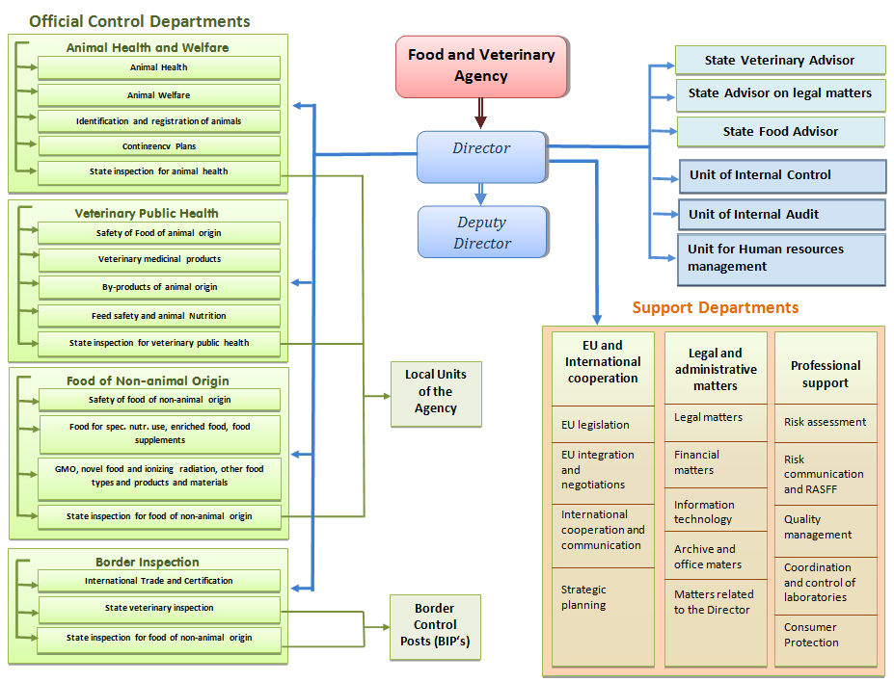

Slide 10
Notification of diseases
Member of OIE
BoR on compulsory notifiable disease
Owner or any other person in contact with animal or material from animal (laboratory, slaughterhouse), private veterinary practices
Official veterinarian
Central Competent authorities

Slide 11
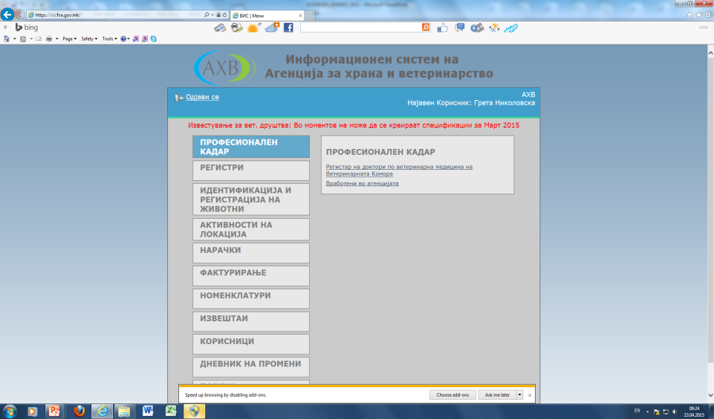
Veterinary information system (VIS)
During 2013 was completed and become operational Veterinary Information system (VIS) is covering animal health and veterinary public health and keeping records, collect data of sampling for laboratory examination and results of testing
Connected with the Laboratory Information System
Database for identification and registration of animals is also an integral part of this information system.
Veterinary Information System (VIS), a system that is intended as a tool to support the implementation of activities for animal health protection in the daily work: - Veterinary associations; - Official veterinarians and - National Reference Laboratory FVM Skopje

Slide 12
Brucellosis in sheep and goats control in Republic of Macedonia

Slide 13
Measures for control of Brucellosis in small ruminants before 2008
Test and slaughter
Laboratory test
Rose Bengal as screening test
CFT or ELISA as confirmation test
Compensation for slaughtered animals at 100% market value
No permanently identified animals
Poor movement control

Slide 14
Test and slaughter < 2008

Slide 15
Test and slaughter < 2008-statistical parameters in infected villages
Parameter | Value
Average prevalence | 10,28%
Median of prevalence | 3,34%
Average number of positive animals | 43
Median of positive animals/village | 7
Estimated number of infected flocks | >1000

Slide 16
Measures for control of Brucellosis in small ruminants before 2008
Correct implementation of diagnostic tests (RB as screening and CFT or ELISA as confirmatory) is very expensive
Timely removal and compensation require great financial resources
Brucellosis is widely spread in the country and the disease prevalence and absolute number of infected animals differ between regions
Based on the disease situation, the prevalence, the country may be divided in three regions:
Regions where the disease is not present or is present in very low prevalence (0-1%)
Regions where the disease is commonly present in low or higher prevalence (1-5%)
Regions where the disease is present in high prevalence (>5%)
The current strategy is inappropriate in terms of implementation of same strategy in different disease situation

Slide 17
Brucellosis control < 2008-Conclusions
A number of inconsistencies have been confirmed during implementation of test & slaughter strategy
Only a proportion of villages (and flocks) are tested and they are not consistent
Retesting in positive flocks is not done continuously
Brucellosis is being spread after lambing (winter) in poor hygienic conditions and testing is continued after lambing which result in a number of new infections
Animals are not permanently identified
Positive animals are not removed consistently

Slide 18
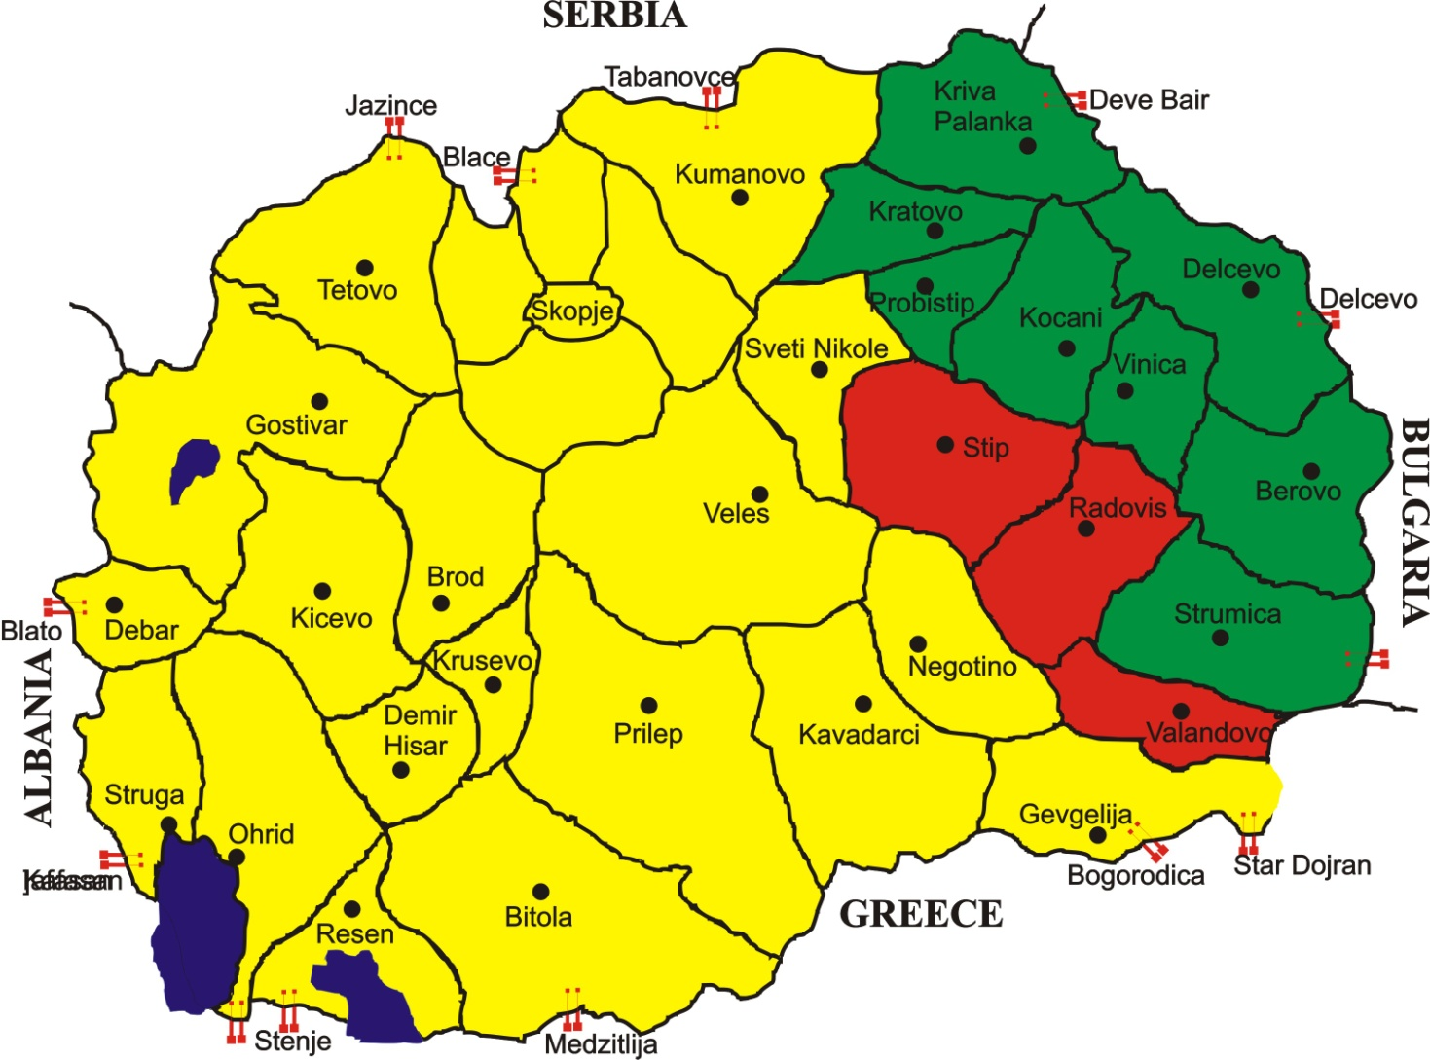
Division of country based on Brucella situation
low prevalence (0-1%)
high prevalence (>5%)
low or higher prevalence (1-5%)

Slide 19
Measures in “green” regions
Vaccination is forbidden
Diagnostic tests on all sheep and goats older than six months
Lambs and kids younger than six months are not tested
Desired status “officially free from Brucellosis”

Slide 20
Measures in “yellow” regions combination of test and slaughter strategy/vaccination
Vaccination of replacement
Vaccination of replacement animals 3-6 months old
Vaccinated animals are tagged with special ear tags
Movement of vaccinated animals is banned four weeks after vaccination
Slaughter of vaccinated animals is allowed three months after vaccination
Vaccination of older sheep and goats is forbidden
Testing of sheep and goats older than 6 months
This approach for at least five years

Slide 21
Diagnostic tests 2010
Identification of the agent
There are no specifically developed serological tests for detecting infection with Brucella melitensis in sheep and goats
BBAT (RBPT)
CFT
AGID tests (differentiation between vaccinated and infected animals)
ZONE WITH VACCINATION OF YOUNG REPLACEMENT ANIMALS
Serological testing of animals older than 18 months
Vaccine induced serological response shouldn’t be detectable 12 months post vaccination

Slide 22
Expected results
Reduce the further spreading of the disease
Decrease the absolute number of positive animals
Decrease the number of positive humans
Decrease financial resources required for control of the disease

Slide 25
Brucellosis control > 2008-2014

Slide 26
Brucellosis control 2008-2014

Slide 27
Brucellosis control > 2008

Slide 28
Brucellosis control-Number of infected people

Slide 29
Conclusions
New strategy have limited success in decreasing of the number of positive flocks
There is improvement of within flock control
Number of positive humans is dramatically decreased
There are savings of financial resources for compensation
Further improvement of the national strategy

Slide 30
Amended strategy for Brucellosis in sheep and goat in 2010 and 2014
In 2010 additional 3 regions with mass vaccination (Skopje, Tetovo and Gostivar) Mass vaccination in epidemiological units based on risk analysis cluster of villages, one village, cluster of flocks or single flocks
During July 2014 amending the program for control and eradication of Brucellosis in sheep and goats (main change is to facilitate the movement of animals between certain Epizootiological units)

Slide 31
Bovine Brucellosis and Tuberculosis
Regular annual diagnostic tests for
Bovine Brucellosis were performed on all cattle older than six months, and
Tuberculosis all cattle older than six weeks with single tuberculin test, retest of all positive herds continuously performed during the year. Private Veterinary station- itradermal test bovine tuberculin. Faculty of veterinary medicine- responsible for comparative intradermal test with avian and bovine tuberculin after at least 6 weeks.
Samples for bacteriological examination are taken from slaughtered animals.
All animals which are find positive are slaughtered with reimbursement of the losses to the owner.

Slide 32
Bovine Brucellosis
Year | No. of tested animal | No. of positive animals | No. of tested herds | No. of positive herds
2009 | 122.285 | 393
2010 | 168.682 | 663 | 4.349 | 78
2011 | 147.615 | 225 | 4.307 | 66
2012 | 144.619 | 416 | 4.511 | 64
2013 | 144.629 | 344 | 25.092 | 46
2014 | 162.582 | 504 | 24.655 | 125

Slide 33
The animal diseases status in Republic of Macedonia (Zoonoses)
Disease | Year of last occurrence
Brucellosis in sheep and goats | 2014
Brucellosis in cattle | 2014
Q-fever (domestic animal) | 2014
Rabies (domestic and wild animal) | 2012
Enzootic abortion of ewes (ovine chlamydiosis) | 2013
West Nile fever (domestic and wild animal) | 2012
Anthrax (domestic animal) | 2009

Slide 34
Gaps and challenges -next steps 1
Revise the achieved results (2015) and adopt revised approach for Brucellosis in sheep and goats
Increase the public health efforts
Strengthen animal I&R and movement control
Strengthen of the epidemiological investigation and tracing back
Introduce and maintaining of classification of status on flocks (Brucellosis)
Prepare for phase out of Brucellosis vaccination strategy
Vector control

Slide 35
Gaps and challenges -next steps 2
New strategy have limited success in controlling the flock incidence
There is improvement of within flock control
There is significant savings of financial resources
Improvement of diagnostic regime
approach the EU legislation schedule (RB+CFT+bacteriology)
more in-depth analysis of the situation and division of the country on more epidemiological units (VIS)
The Programme for control and eradication of Brucellosis should be extended to the wild animals in the whole territory of the country

Slide 36
Thank you on your attention
Food and Veterinary Agency
Animal Health Department

