Slide 1
Zoonosis diseases
Dr. Silvia Pessah-Eljay
Zoonosis Disease.
Epidemiology Division
Zoonosis Unit. Feb, 2015
S.Pessah-Eljay. MD., MPH., MS

Slide 2
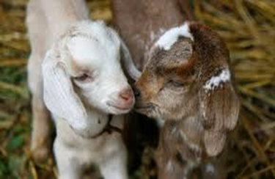
Brucellosis

Slide 3

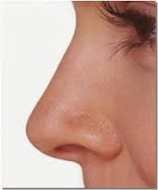
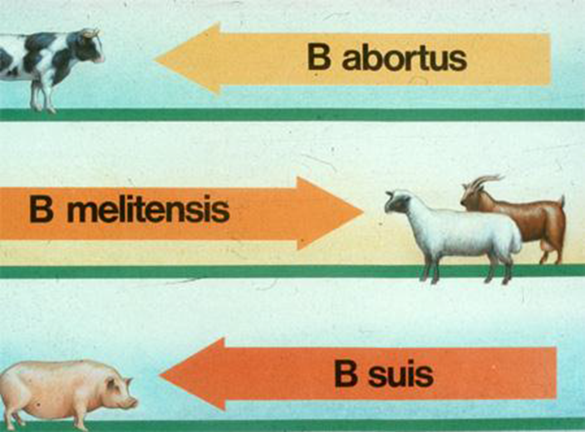


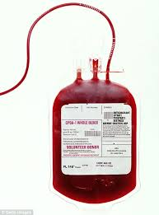


Brucellosis: Agent and transmission
Agent: Brucella sp.
Transmission
  Respiratory
  Gastrointestinal
  Wounded skin
  Other (transfusion, transplants)
B. canis
B. pinnipediae

Slide 4
Brucellosis: Epidemiological cycle
http://www.frontiersin.org/files/Articles/82508/fmicb-05-00213-HTML/image_m/fmicb-05-00213-g001.jpg

Slide 5
Brucellosis: Clinical manifestations
The disease of the 1,000 faces
Incubation: 5 days to months
  Classification according to the duration of the disease
  1-8 weeks. Acute or bacteraemia
  9-52 weeks: Subacute
  > 52 weeks: Chronic
  According to the clinical manifestations
  With Unspecific clinical symptoms:
    Fever, chills, sweats
    Weakness, fatigue, headache
    Enlargement of liver and spleen
    Lynphadenopaties
    Depresion
    Joint, muscle and back pain
  With Specific clinical symptoms (localized):
    Arthritis / Osteomyelitis (20-35%)
    Genitourinary infections (2-20%)
    Neurobrucellosis (3*5%)
    Carditis, endocarditis (<2%)
    Others

Slide 6
Brucellosis: Case definition
Probable case
Clinical compatible:
Epidemiologically linked to a confirmed human or animal brucellosis case
Lab:
* Brucella total antibody titer of greater than or equal to 160 (SAT) or
* Brucella microagglutination test (BMAT) in one or more serum specimens
* Detection of Brucella DNA in a clinical specimen by PCR assay
Confirmed case
Clinical compatible:
Epidemiologically linked to a confirmed human or animal brucellosis case
Lab:
* Culture and identification of Brucella from clinical specimens
* Evidence of a fourfold or greater rise in Brucella antibody titer between acute- and convalescent serum specimens obtained greater than or equal to 2 weeks apart
Notes:
Laboratory Criteria for Diagnosis
Definitive Culture and identification of Brucella spp. from clinical specimens
Evidence of a fourfold or greater rise in Brucella antibody titer between acute- and convalescent-phase serum specimens obtained greater than or equal to 2 weeks apart
Presumptive Brucella total antibody titer of greater than or equal to 160 by standard tube agglutination test (SAT) or Brucella microagglutination test (BMAT) in one or more serum specimens obtained after onset of symptoms
Detection of Brucella DNA in a clinical specimen by PCR assay
Case Classification
Probable
A clinically compatible illness with at least one of the following: Epidemiologically linked to a confirmed human or animal brucellosis case
Presumptive laboratory evidence, but without definitive laboratory evidence, of Brucella infection
Confirmed
A clinically compatible illness with definitive laboratory evidence of Brucella infection

Slide 7
Brucellosis: National data of human cases. Epidemiology Division
Report is mandatory since 1951
Passive surveillance
In the last years there is no changes in the case definition
Number of real cases are underestimated
National data of human cases. Epidemiology Division

Slide 8
Brucellosis: National data of human cases. Epidemiology Division
National data of human cases. Epidemiology Division

Slide 9
Brucellosis: National data of human cases. Epidemiology Division

Slide 10
Brucellosis: National data of human cases. Epidemiology Division

Slide 11
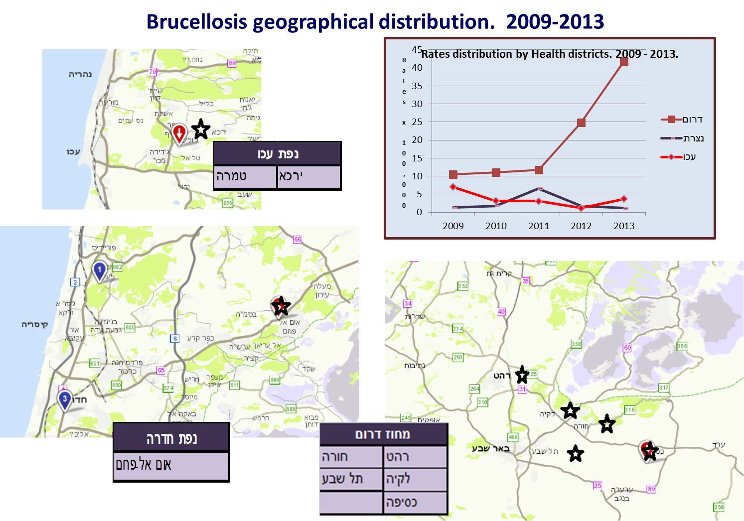
Brucellosis: National data of human cases. Epidemiology Division

Slide 12
Brucellosis: Treatment & Prevention
Treatment
  Adults and > 8 years old:
    Doxicyclin 200mg/kg/d x 6 weeks +
      Sreptomycin 1 gr/d x 2-3 weeks or
      Rifampicine 600-900mg/d x 6 weeks
  Children < 8 years old:
    CMX 2x8/40 mg/kg/d x 6 weeks +
      Sreptomycin 30 mgr/kg/d x 3 weeks or
      Rifampicine 15mg/kg/d x 3 weeks
  Pregnant women:
    Doxicyclin 200mg/kg/d x 6 weeks +
      Rifampicine 600-900mg/d x 45 days or
      CMX
      WHO regimen
Prevention
  Avoid unpasteurized dairy foods
  Cook meat thoroughly. Cook all meat until it reaches an internal temperature of 145 to 165 F (63 to 74 C)
  Wear gloves. Veterinarian, farmer, hunter or slaughterhouse worker, wear rubber gloves when handling sick or dead animals or animal tissue or when assisting an animal giving birth
  Take safety precautions in high-risk workplaces
  Vaccinate domestic animals

